Slide 1
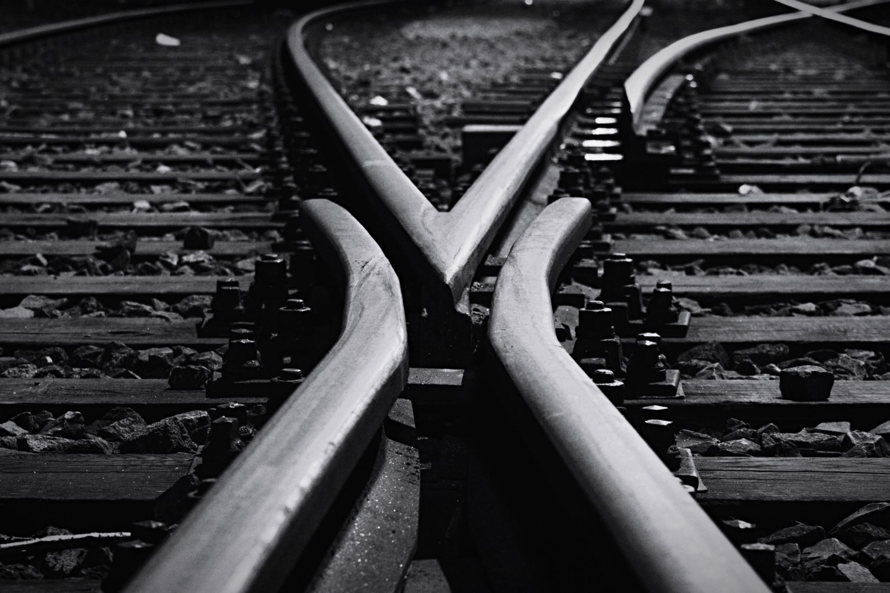

Teamsters Canada rail conference
Local Chair Training Program

Slide 2

“Education provides the path to knowledge; knowledge creates the steps to progress”
Notes:
Opening – this quote is bottom of president’s message

Slide 3
Teamsters Canada rail conference
Education Programs
Notes:
Opening
Promote online presence in next 4 slides before continuing at page 3 of workbook.

Slide 4
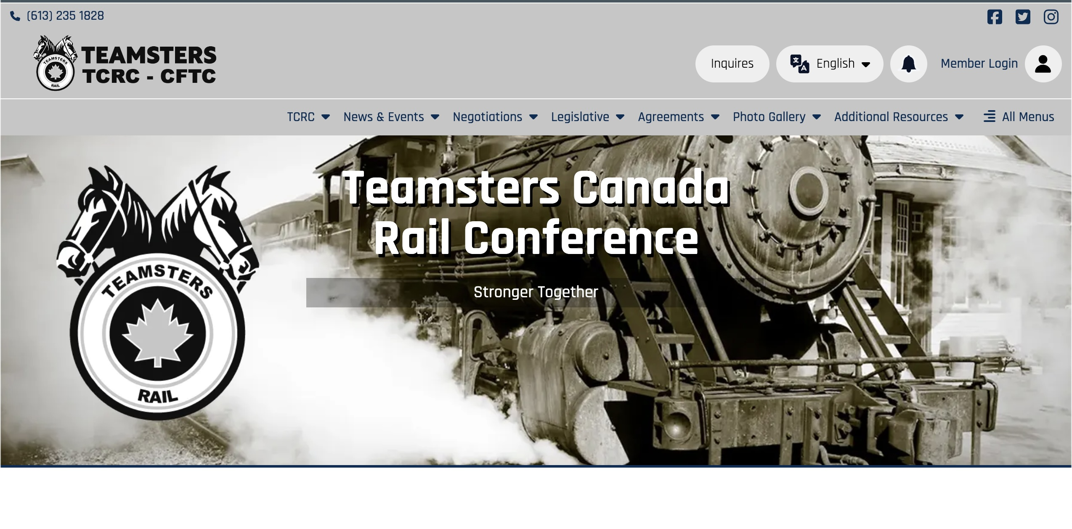
www.teamstersrail.ca
Notes:
New website as of December 2023

Slide 5

Notes:
TCRC App launched December 2023. Every participant will also have cards with the URL code to take back to the Division.
This is the best way to stay informed. Ask every Officer to promote the app in their Division.

Slide 6

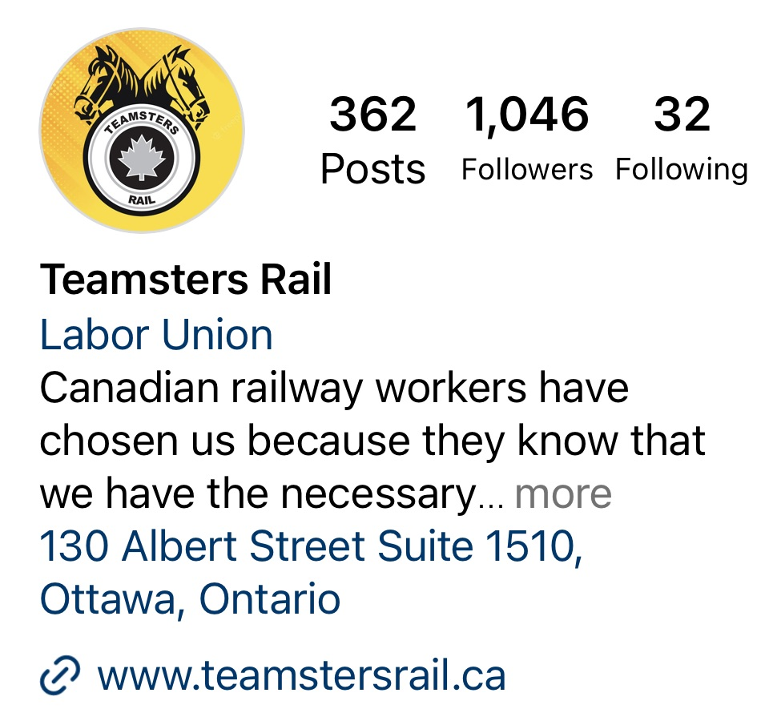



Social media - TEAMSTERS RAIL
Facebook : https://www.facebook.com/TeamstersRail
Twitter : https://twitter.com/TeamstersRail
Instagram : https://www.instagram.com/teamstersrail/
YouTube : https://www.youtube.com/@TeamstersRail
Threads : YouTube : https://www.youtube.com/@TeamstersRail
Notes:
Important – TCRC APP! Not part of manual because recent addition.

Slide 7
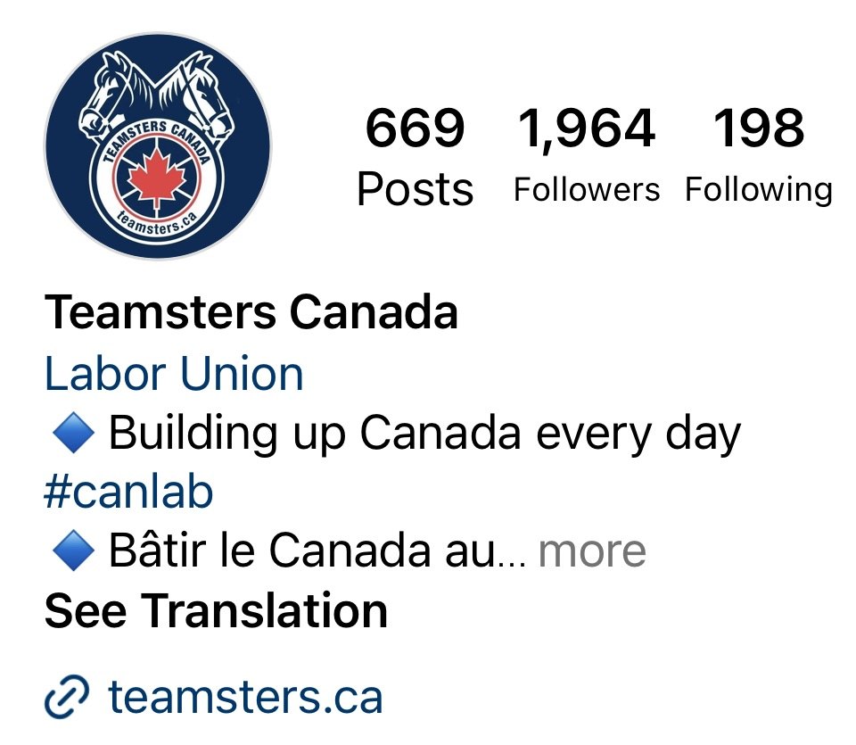

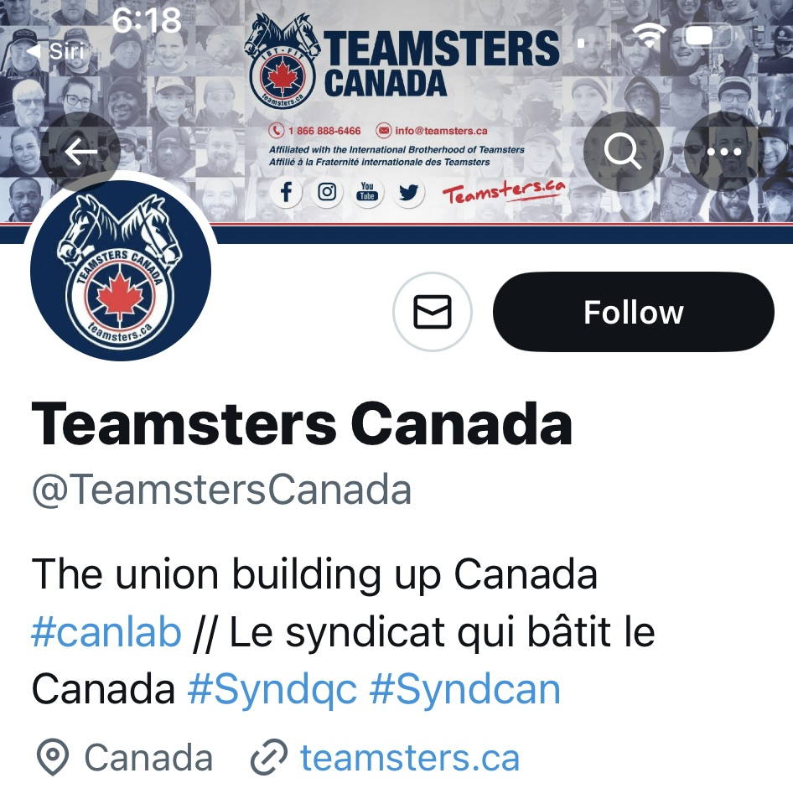

Social media - TEAMSTERS CANADA
Facebook : https://www.facebook.com/Teamsterscanada/
Twitter : https://twitter.com/TeamstersCanada
Hashtags on Twitter : #canlab #Syndcan #polcan #Cdnpoli
Instagram : https://www.instagram.com/teamsterscanada/
YouTube : https://www.youtube.com/channel/UC8FHp8lFGbNhT9wX2lGfJbA

Slide 8

Notes:
Also place for BRCF to speak and promote

Slide 9
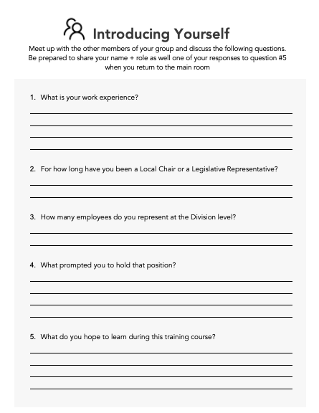


Find your worksheet
Complete the worksheet on your own and be prepared to share your answers with others in a few minutes.
Turn your camera OFF now, and then back ON once you are done your worksheet, so that I know you are ready to proceed
Notes:
Introductions page 4

Slide 10
Notes:
INSTRUCTOR - STOP sharing your slides

Slide 11
OBJECTIVES
Build skills and confidence
Know our history and structure
Define roles and responsibilities
Handle disputes
Learn investigation and representation skills
Understand grievances
Handle grievances
Draft grievances
Understand arbitration
Overview of labour laws
Notes:
Objectives page 5

Slide 12
Sometimes, our members don’t know (or forget) the importance of being unionized, particularly in the 21st century, when the economy and globalization are constantly challenging our working conditions. For this reason, it is our role to educate and inform our co-workers about our union structure and history, in order for them to better understand the struggles our leaders went through, and the reasons why we still need to be united to maintain and improve our life and working conditions.
Notes:
Start of Section l - History and Structure

Slide 13
Notes:
INSTRUCTOR - STOP sharing your slides

Slide 14

B
Question #1
Label this chart by filling in the blanks.
A:_____________ B:_________
Management Rights, Union Rights
Labour Law, Union Rights
Management Rights, Labour Laws
Labour Laws, Management Rights
A
Notes:
Without a Union/With a Union
Correct answer is:
Management Rights, Labour Laws
Top Up to include:
Without a Union, the employer has few limitations on how to treat employees and
organize work. A non-unionized employee is only protected by the minimum
standards of the relevant labour laws. If there is a violation of a section of the
labour law, or any regulation, the employee has a choice to act alone or to hire his
own lawyer to defend himself against his employer. Employers sometimes abuse
their power or ignore the Labour Standards including Health and Safety
Regulations, knowing that it takes a lot of courage and money for a non unionized
employee to file a complaint against them and to be successful. When faced with
such an employer, nonunionized workers often quit that job and simply move on.

Slide 15
Question #2
Non-unionized workplaces do not have the benefit of______ (select the correct answer)
Health and Safety Regulations
The grievance procedure
Labour Standards
Notes:
Without a Union/With a Union
Correct answer is:
The grievance procedure
Top Up to include:
Even non-unionized workplaces have labour laws and regulations in place, however they do not have the grievance procedure for issues that lie outside these laws

Slide 16
Question #3
The terms and conditions of employment become part of the Collective Agreement by:
Negotiation by the Union and by vote of the Union membership
Drafting by the Employer and by vote of the Union Bargaining Agent
Drafting by the Union and by vote of the Employer representatives
Drafting according to Provincial and Federal Labour Codes
Notes:
Without a Union/With a Union
Correct answer is:
Negotiation by the Union and by vote of the Union membership
Top Up to include:
In certain situations, an arbitrator may decide on the terms of a Collective
Agreement, in whole or in part. However, it is usually the result of a negotiation
between the parties. The rights and obligations of the employees and the
Employer are therefore provided under the original and exclusive agreement. It is
through the Collective Agreement that employees dictate the limits of management
rights, thus the importance of maintaining solidarity amongst members, in order to
have the edge on the Employer during negotiations. It may happen that one party
or the other does not respect the Collective Agreement or any Labour Laws. Then,
the aggrieved party may resort to the grievance procedure.

Slide 17
Question #4
Even in a unionized environment, an employer has the right to introduce workplace policies. If they do so, what are some of the conditions the rule must satisfy? (select all that apply)
Must be consistent with the collective agreement and any applicable law
It must be reasonable
It must be clear and unequivocal
It must be agreed to by the Union
Notes:
Without a Union/With a Union
Correct answer is:
Last one is not correct
Top Up to include:
There is a long-standing case that outlines the governing jurisprudence with respect to the introduction of an employers’ policy. - Refer to the workbook for additional details.

Slide 18
Notes:
INSTRUCTOR - STOP sharing your slides

Slide 19
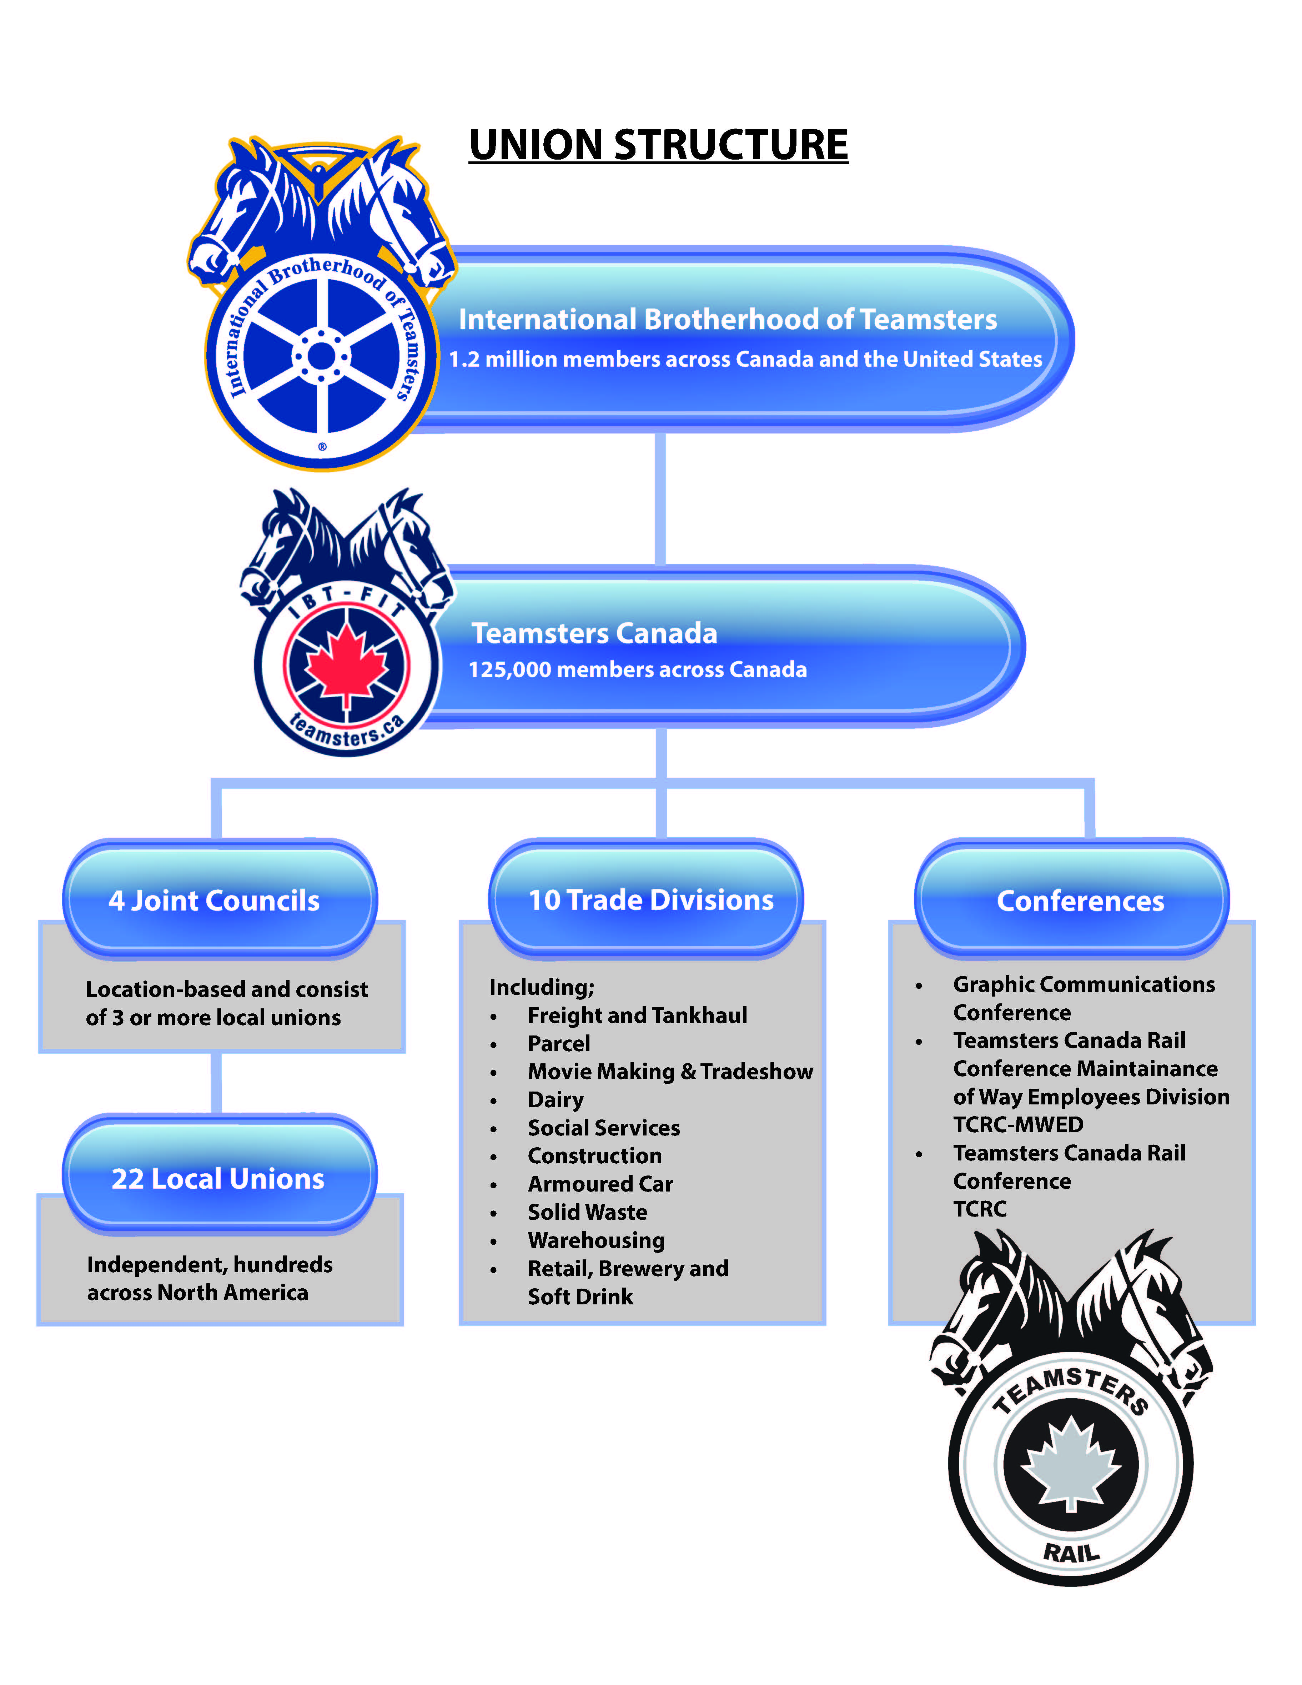
Notes:
Page 14 of Learner Workbook (22 of pdf)
IBT and Teamsters Canada. Explain the differences between TC Locals and our Divisions. We kept our old structure (BLE) when we merged with Teamsters Canada, so in order to establish Divisions a Conference was required. Under IBT rules our Conference has the same rights a TC Local

Slide 20
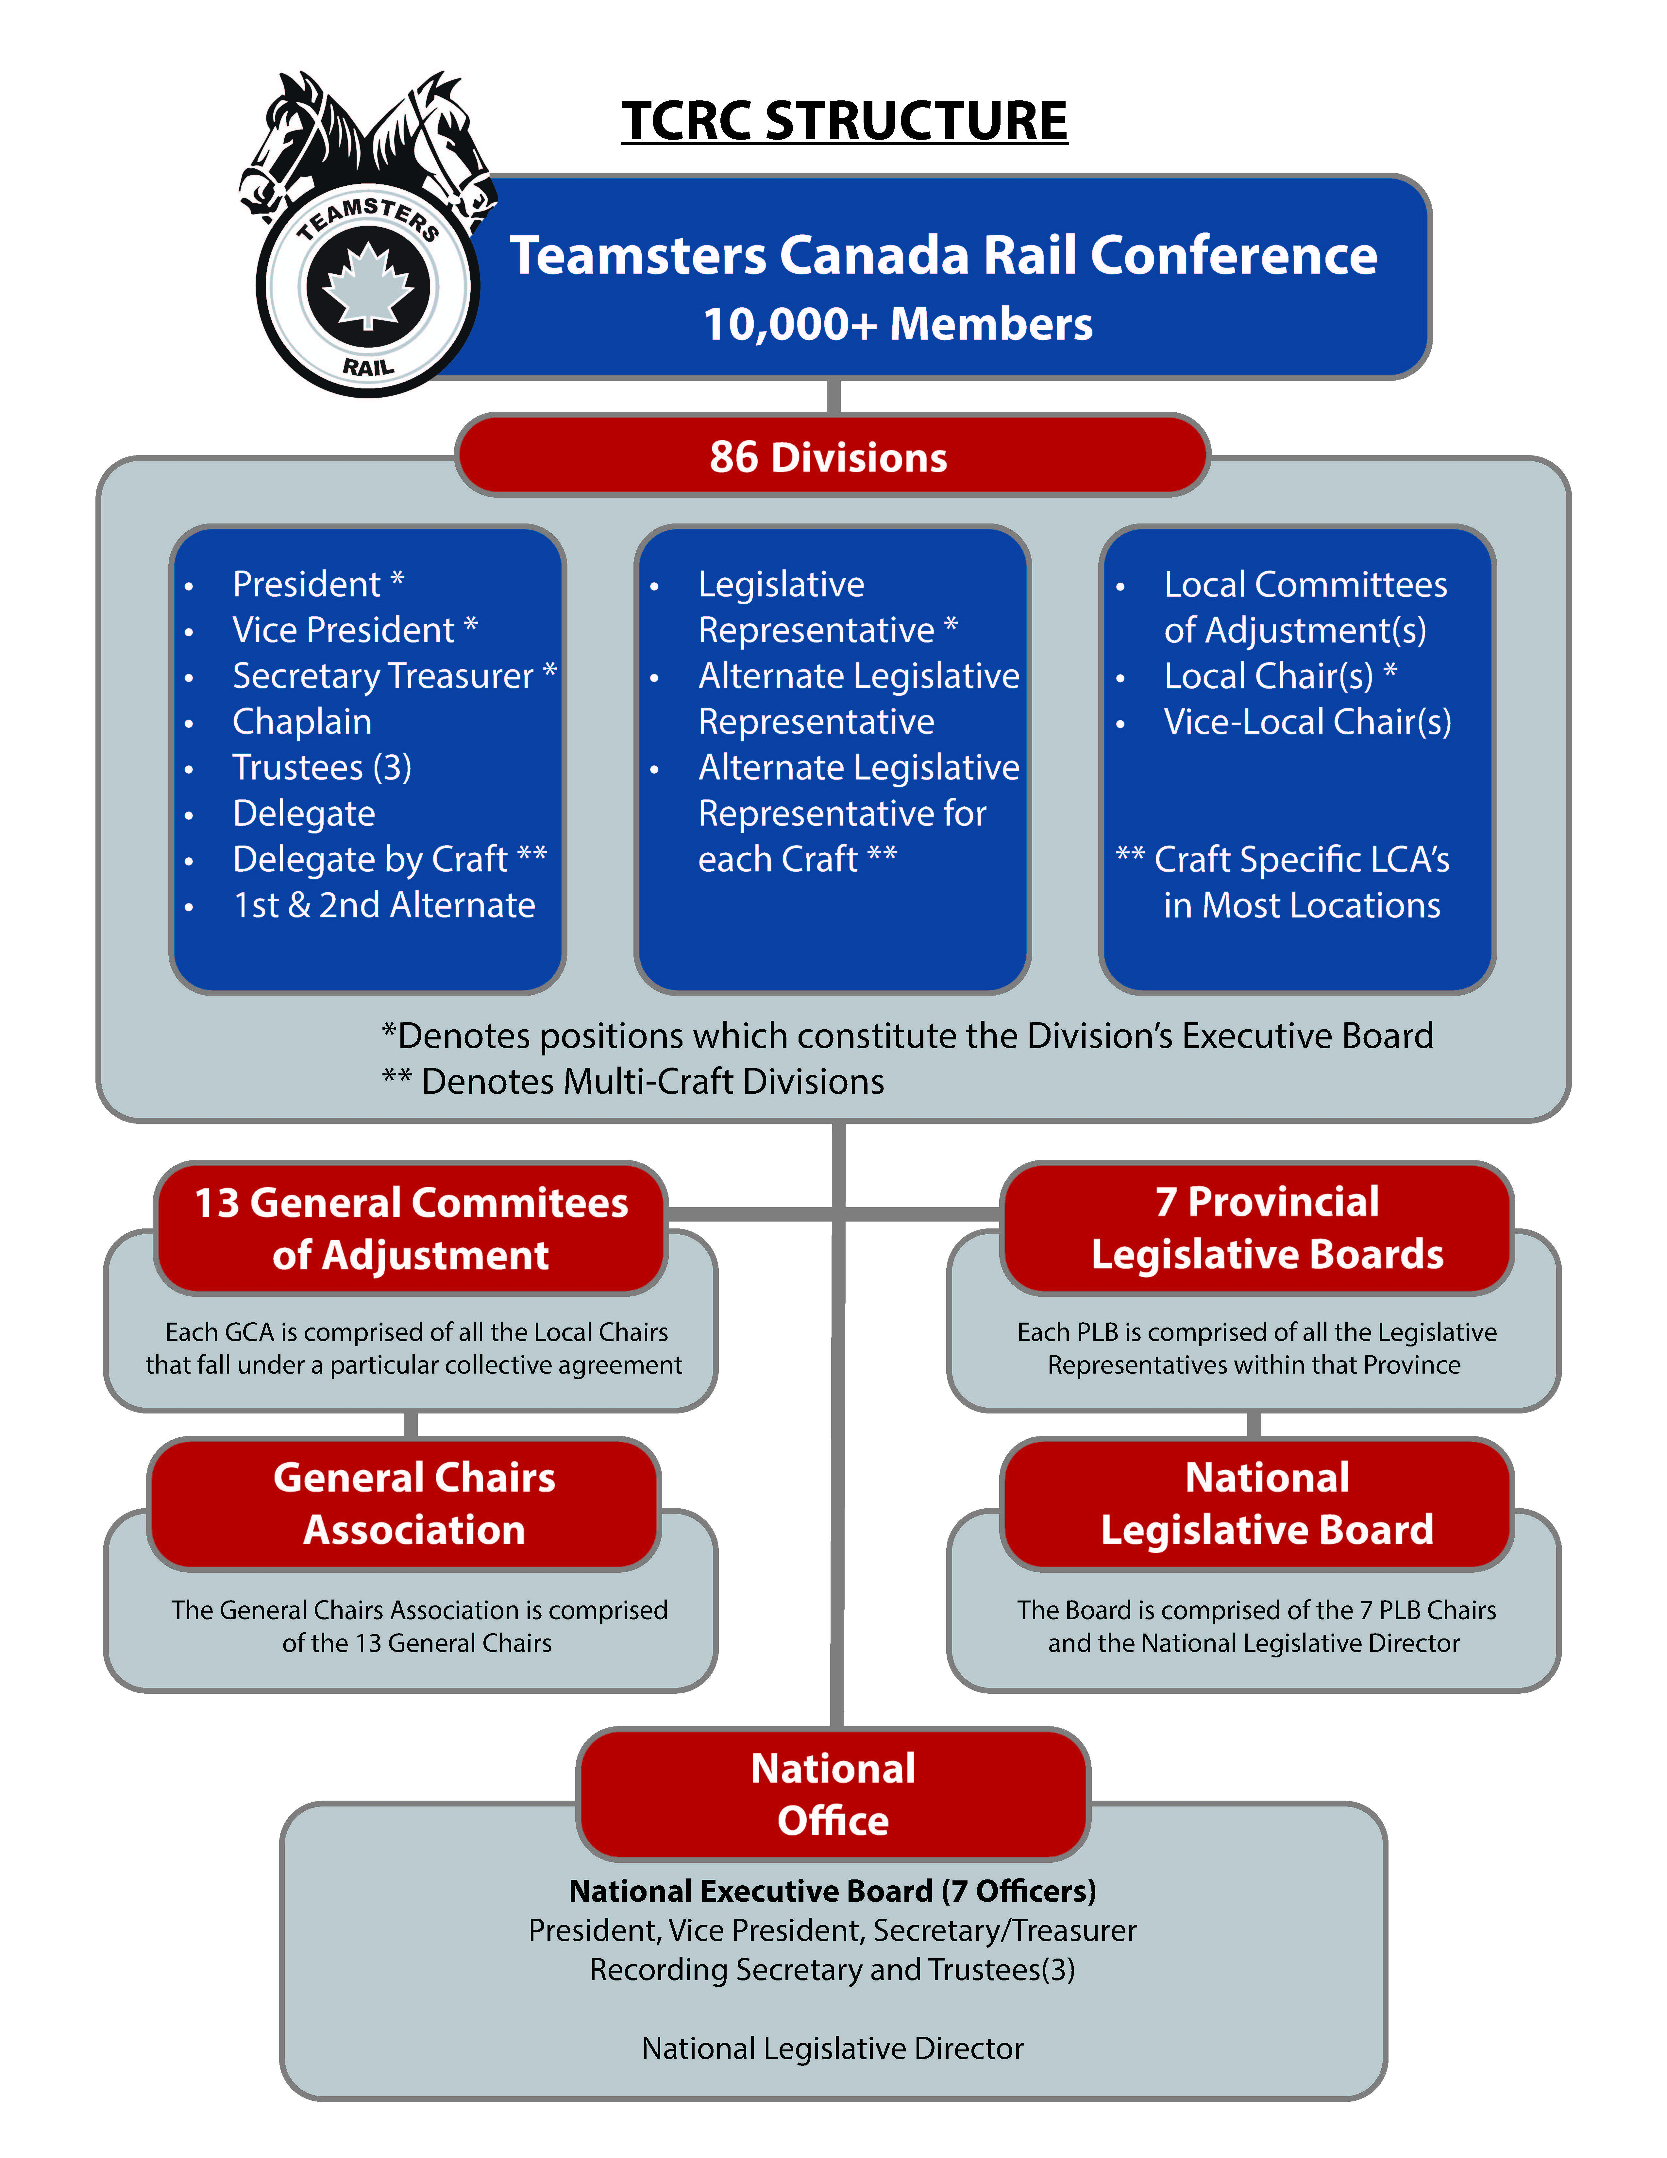
Notes:
Page 15 of Learner Workbook (23 of pdf)
Explain and question whether there is understanding between GCAs and National Office. Roles and responsibilities (primarily CA issues with GCAs).

Slide 21
In the past, a distinct separation has existed between the legislative and protective elements of our union(s). This has hindered the effective representation of our members. As a result, one of the goals we have is to eliminate this division by reinforcing the importance of the various division officers working as a team to benefit our members. Learning each others' roles and responsibilities is an important part of this process. This section deals with the roles and responsibilities of the local chairs, remembering the same principles apply to all Division Officers. This will ensure that Local Chairs will have a better understanding of how to work together, with Division Officers to help our members receive the assistance they require.
Notes:
Start of Section ll - Roles and Responsibilities

Slide 22

1-You are the new Division Officer, and you want to build up solidarity within the membership of your Division. What do you do?
Notes:
Working Better With the Members
Question #1

Slide 23
Notes:
INSTRUCTOR - STOP sharing your slides

Slide 24
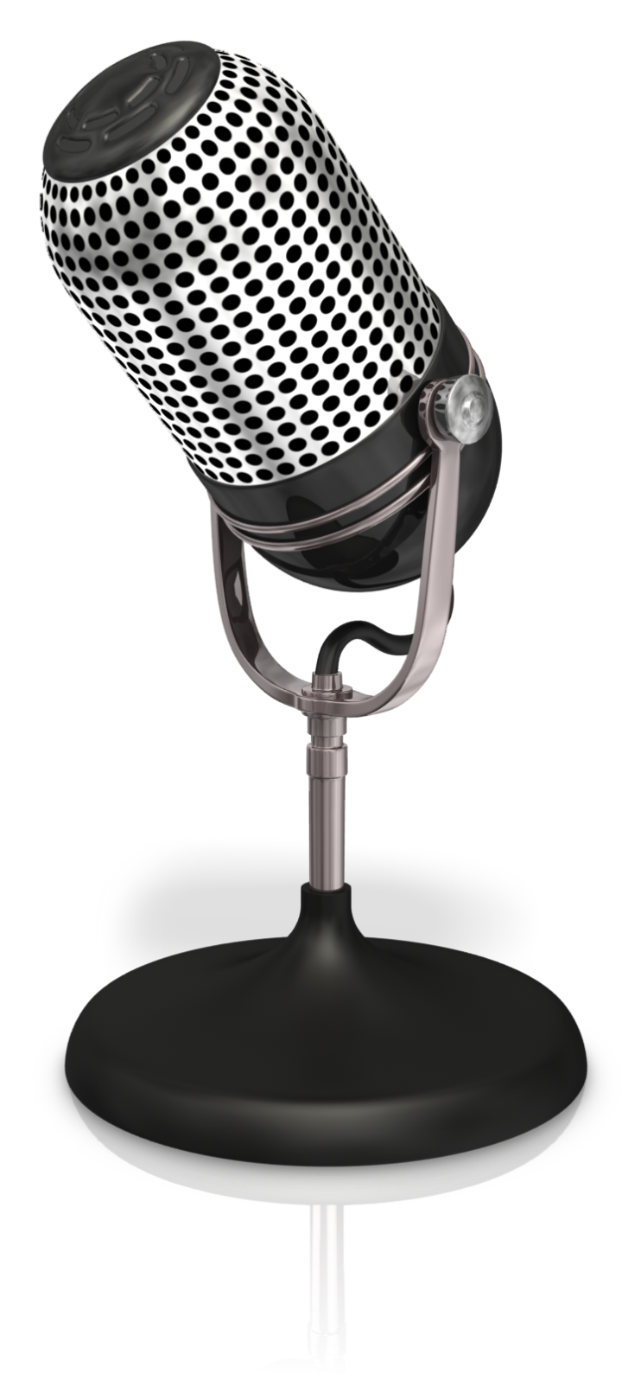
2 - A member comes to you with a complaint. After investigation, you decide based on precedent cases and the Collective Agreement, that it is not a valid grievance. He insists to file a grievance. What do you do?
Notes:
Working Better With the Members
Question #2

Slide 25
3 - A member worked overtime but gets paid at regular rate. He is entitled to file a grievance but refuses to do so. What do you do?
Move on - you have lots on your plate already.
Find another member with the same issue and have him/her file a grievance.
File the grievance yourself.
Any additional ideas?
Notes:
Working Better With the Members
Question #3

Slide 26
4 - The employer introduces a new policy. A small group of employees come to you to complain. What do you do?
Tell the employer to change the policy immediately.
File a grievance.
Discuss the issues with the members and employer representatives.
Any additional thoughts?
Notes:
Working Better With the Members
Question #4

Slide 27
5 - The employer introduces changes in clear violation of the collective agreement. After investigation, you realize that the majority of the membership agrees with the violation and don’t want to file a grievance. What do you do?
Let it go.
File a grievance.
Ask the General Chairman for help/advice
Any additional thoughts?
Notes:
Working Better With the Members
Question #5

Slide 28

6 - A member approaches you with information that he injured his back while at work 10 days previously. The local manager convinced him to not report the injury to workers compensation. The member had seen a doctor, but did not disclose the ailment was work related. The members’ back continues to hurt him and he doesn’t know what to do. What do you do?
Notes:
Working Better With the Members
Question #6

Slide 29
7 - Young employees are hired by the company. What do you do?
Notes:
Working Better With the Members
Question #7

Slide 30
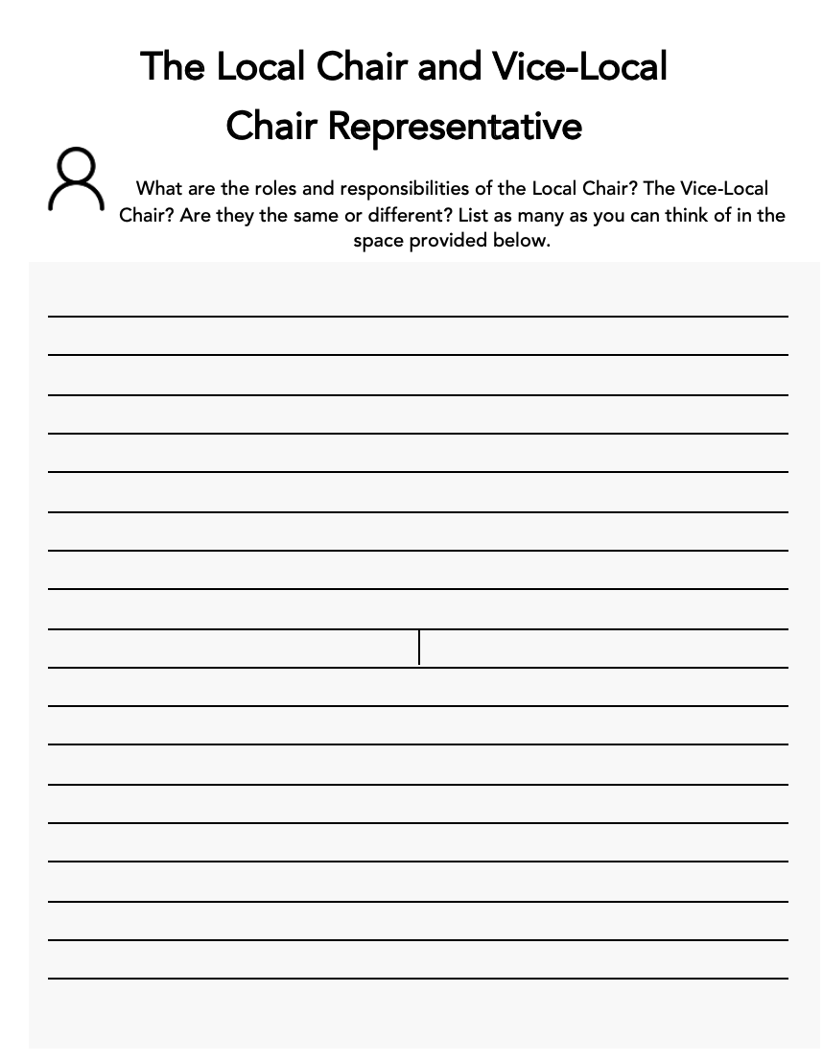
Find your worksheet
Complete the worksheet on your own and be prepared to share your answers in a few minutes.
Turn your camera OFF now, and then back ON once you are done your worksheet, so that I know you are ready to proceed
Notes:
Local Chair and Vice-Local Chair Representative

Slide 31

The Local Chair and vice-chair roles and responsibilities
Notes:
Local Chair and Vice-Local Chair Representative

Slide 32

Video - TBD
Notes:
TBD – placeholder. Video “Day in the Life” not currently available.

Slide 33
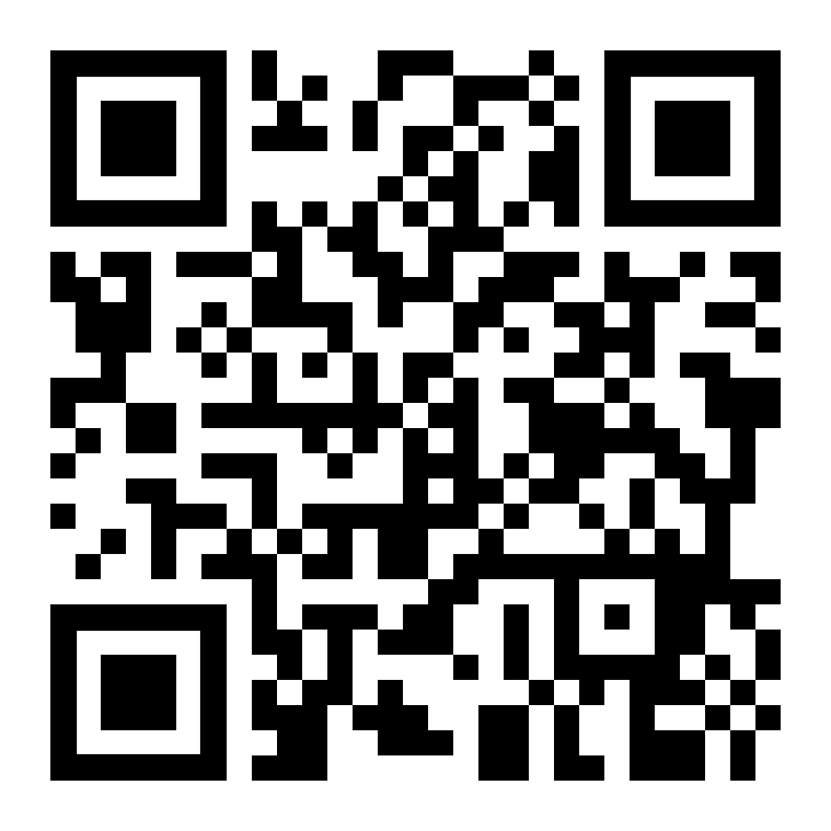
The Duty of Fair Representation
Notes:
Duty of Fair Rep - pages 28-29
Pull this up before you need it and have it open in the background: https://youtu.be/DGr504hIYhw

Slide 34
Section 37
A union cannot act in a manner that is:
Arbitrary
Discriminatory
In bad faith
Notes:
Duty of Fair Rep - pages 28-29

Slide 35
Does not apply outside of a collective agreement
WBIB claims
Agreements under special Acts
Internal Union politics
Taking grievances up on judicial review
Negotiation of Back-to-Work Protocols
Notes:
Duty of Fair Rep - pages 28-29

Slide 36
An arbitrary decision is…
A random decision
A decision not based on any general rule
A decision based on whim with little regard for the facts
Notes:
Duty of Fair Rep - pages 28-29

Slide 37
A discriminatory manner is…
A decision that singles a person out and treats them unfairly on the basis of an irrelevant characteristic or ground
A decision based upon invidious distinction without labour relations rationale
Notes:
Duty of Fair Rep - pages 28-29

Slide 38
Bad faith is…
Akin to acting with malice, ill will or dishonesty
Serious negligence
A total lack of representation
Notes:
Duty of Fair Rep - pages 28-29

Slide 39
A grievor’s story
I was walking over by track #11, and at the piggyback ramp there were two Trainmasters, Jim and Geoff. Jim was operating the locomotive, and Geoff was giving signals spotting the special car.
I yelled over at Geoff that he wasn’t supposed to be doing bargaining unit work. He said “The yard crew is busy doing other work and the car has to be unloaded by 3 p.m., so mind your own business!”. I yelled at him that he was always causing these kinds of problems, and that the yard crew would be back at 2:30 p.m. I told him the loaded car had been sitting around for four days, and I pointed at the other yard engine moving in our direction over Geoff’s head.
Jim, who had climbed off the locomotive, pushed me and said “Don’t you try to hit him!”. I didn’t say anything, and they went to see the Superintendent. Now I’m faced with a formal investigation for taking a swing at a supervisor.
Notes:
Getting Your Facts Straight pages 30-31
The purpose of this exercise is to illustrate the distortions in communicating information from the original source, through several individuals, to the final destination. This exercise also demonstrates the importance of local chairpersons properly investigating rumours and getting the facts straight.
The instructor will ask 6 participants to relay the message. Five of the 6 participants are asked to step outside the room.
The rest of the participants should then read the scenario. When the story is being transmitted, all other participants will be recording any additions, deletions and distortions of the message. The one selected participant still in the room has 2 or 3 minutes to learn the message.
The instructor brings a second participant back into the room from outside and the 1st participant relays the message to this 2nd participant, who in turn must repeat out loud to the group what she/he has learned from the 1st participant’s message. It is important that each participant transmit the message in her/his own way, without the help of other participants, the observers or the message in front of them.
Repeat the process until all of the selected participants have individually had the message transmitted to them.
The instructor will then lead a short discussion with the class on the implication of the exercise. What did the class observe? How should a union representative have handled receiving a message? Did they write the message down? Did they use any of the 6 W’s?

Slide 40
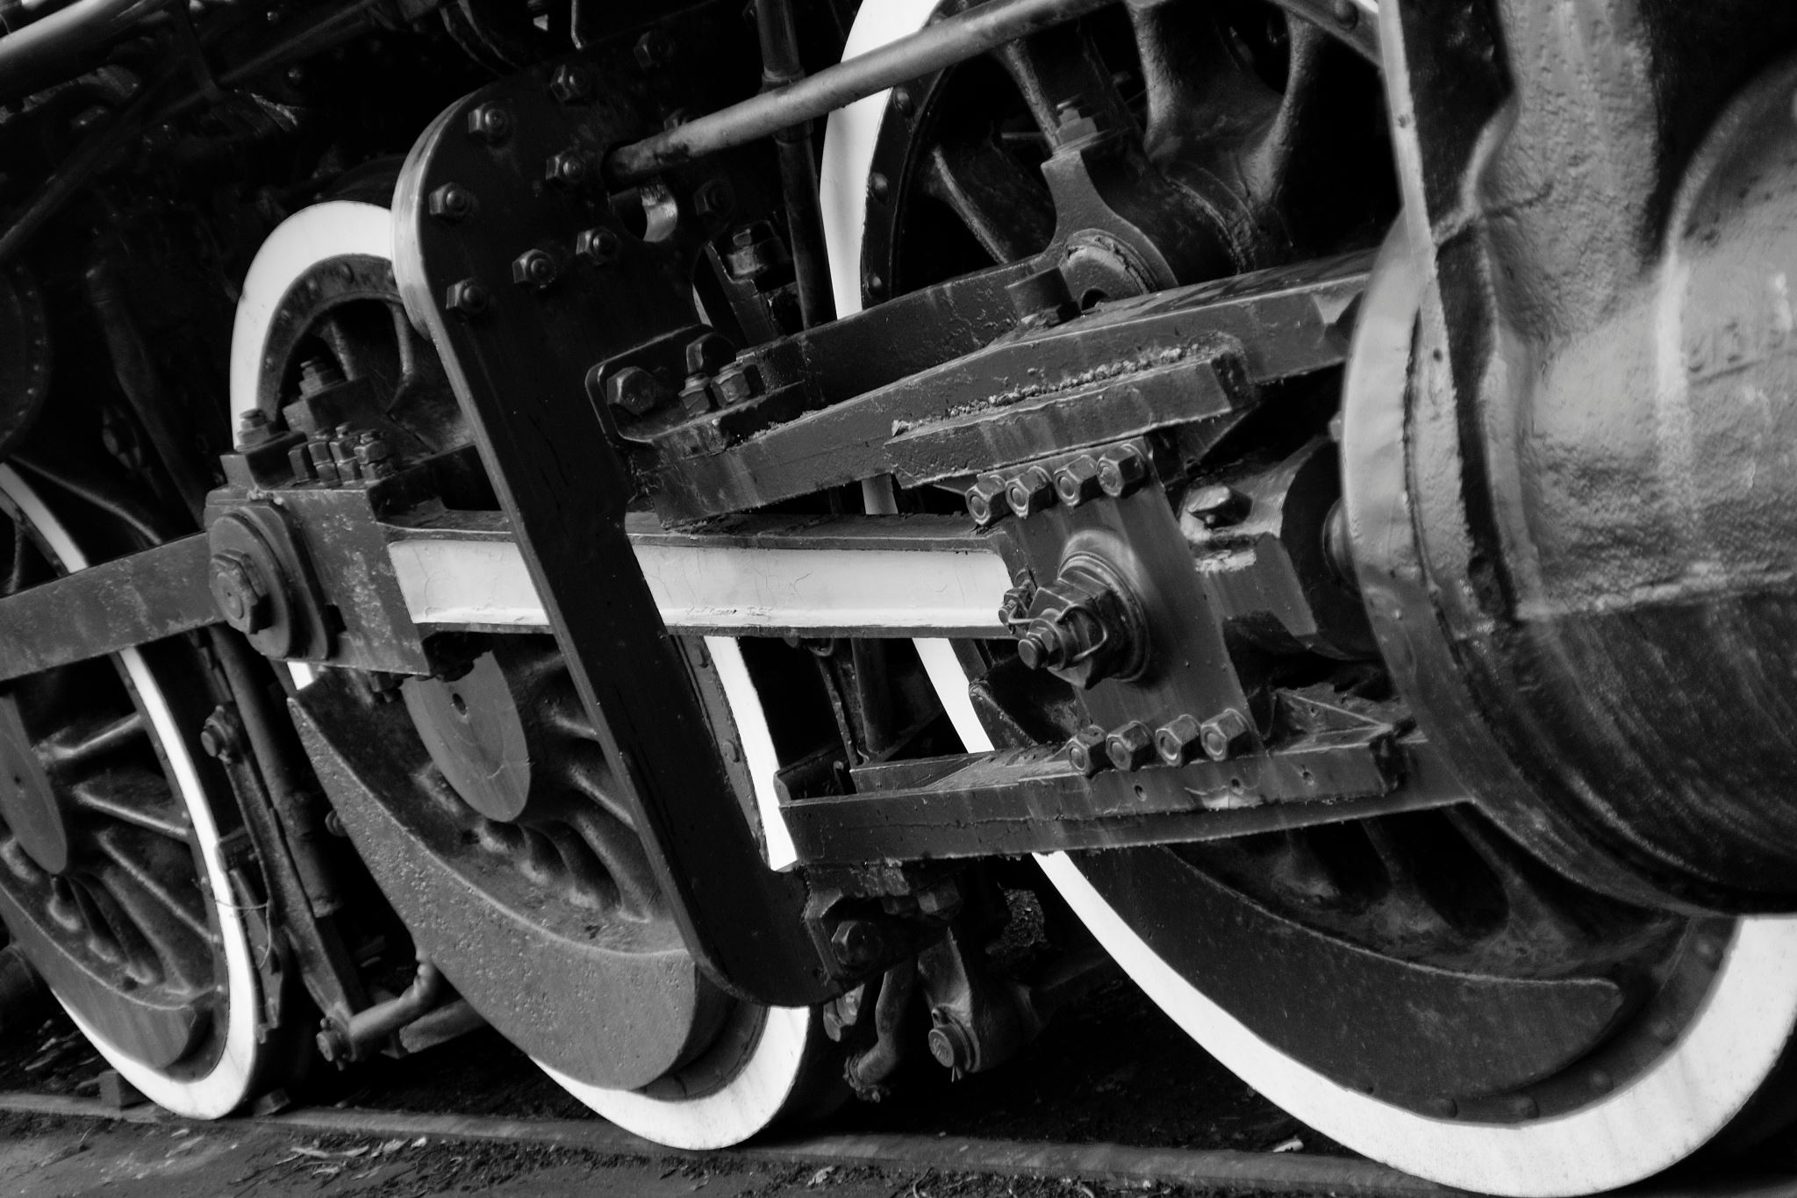
LISTENING
Notes:
How to Better Listen to our Members pages 32-35

Slide 41
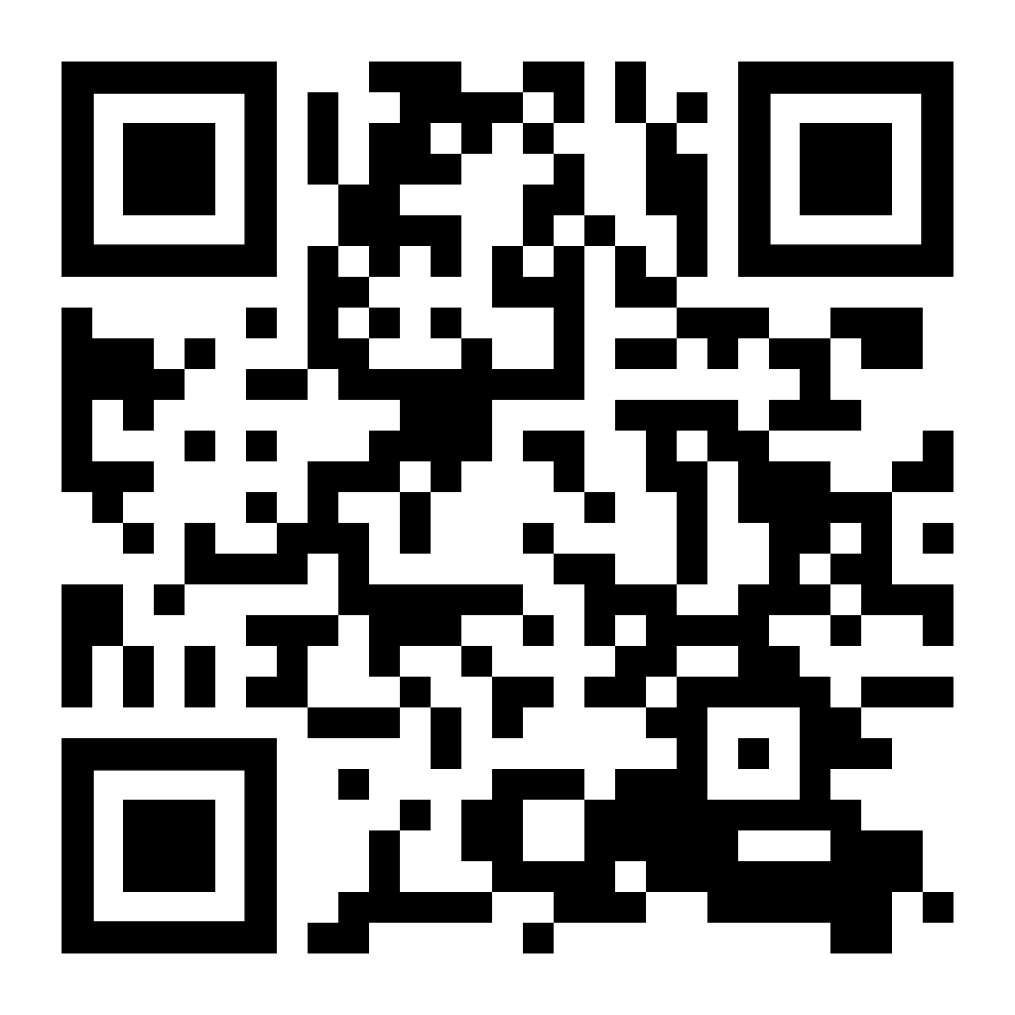
10 Rules for Effective Communication
Notes:
https://youtu.be/R1vskiVDwl4

Slide 42
Active listening
Empathy
Respect
Authenticity
Trust
Notes:
How to Better Listen to our Members pages 32-35

Slide 43
Speaking with members
Initial contact
Listening
Respecting members
Raising awareness
Taking the time
Notes:
How to Better Listen to our Members pages 32-35

Slide 44
Notes:
INSTRUCTOR - STOP sharing your slides

Slide 45
As a division officer it is mandatory to learn how to handle a dispute, and determine whether it is a complaint or a grievance.
Notes:
Start of Section lll - How to Handle a Dispute?

Slide 46
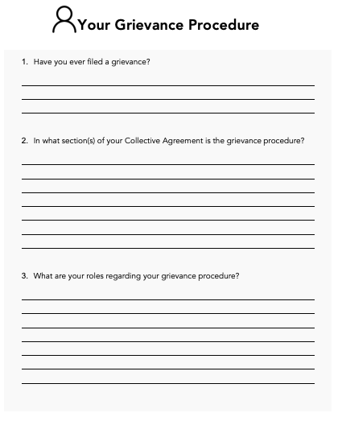
Find your worksheet
Complete the worksheet on your own and be prepared to share your answers with others in a few minutes.
Turn your camera OFF now, and then back ON once you are done your worksheet, so that I know you are ready to proceed
Notes:
Your Grievance Procedure page 40

Slide 47
Notes:
INSTRUCTOR - STOP sharing your slides

Slide 48
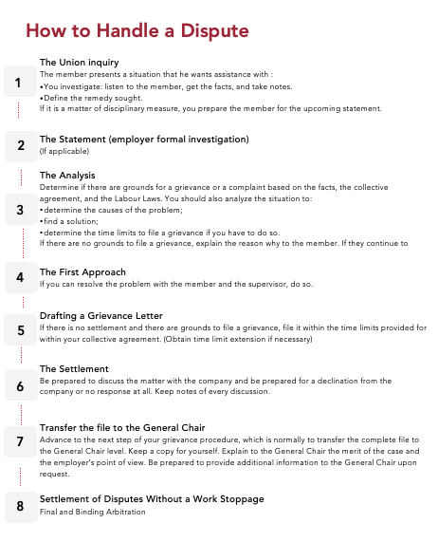
Notes:
How to Handle a Dispute page 41

Slide 49
Notes:
INSTRUCTOR - STOP sharing your slides

Slide 50
The Union Inquiry: A fact-finding mission
Whether we are dealing with a complaint or a grievance, the union inquiry is crucial and will proceed the same way. We have seen how important it is to listen to the members, understand their concerns and try to correct problems, in order to establish our credibility to the employer and the membership and to build a strong Union.
A member may contact you in a variety of ways to discuss a matter with you. You may also find out about a situation through another member, or you may witness the cause of a grievance yourself. Regardless, you need to listen to the member (or a group of members), and it is best to meet face to face.
The search for facts by the Union Representative is called a Union inquiry. It must be taken seriously, since a poorly done, inquiry can mean losing a legitimate case. For example, a lack of information, or incorrect information about a past discipline record would result in the Local Chair or General Chair to be unprepared when discussing a grievance with the employer and could be major reason why a discipline grievance is unsuccessful.
Establish the facts. Write them down, always! Keep notes of all conversations, or observations. Consider using a Union inquiry report and a witness deposition. Start a file, keep records.
If it is a very serious situation, you should immediately consult with the General Chair and work closely together throughout the entire situation. Depending on the seriousness of the situation, the General Chair may utilize legal counsel for initial advice.
Notes:
The Union Inquiry: A Fact-Finding Mission pages 43-45

Slide 51
1 - who
Who is the member involved?
Are there any witnesses involved? (customer, employee)
Who is the manager involved?
Notes:
The Union Inquiry: A Fact-Finding Mission pages 43-45

Slide 52
2 - what
What happened?
Is there a specific clause, practice, regulation or law that applies?
What is the monetary claim, if any?
What are the relevant time limits? (Do you need an extension?)
Notes:
The Union Inquiry: A Fact-Finding Mission pages 43-45

Slide 53
3 - when
When did it happen? (time, date, year)
When did it become a dispute?
When did the employer issue the discipline?
When are you going to become involved?
Notes:
The Union Inquiry: A Fact-Finding Mission pages 43-45

Slide 54
4 - where
Where did the event or the cause of the grievance happen?
Jurisdiction (Yard, Road, Bunkhouse, a siding)
Where was the griever situated (the witness, if any), at the relevant time?
Notes:
The Union Inquiry: A Fact-Finding Mission pages 43-45

Slide 55
5 - why
Why is this considered to be a grievance?
Why did the problem occur? (What was the cause of the problem?)
Notes:
The Union Inquiry: A Fact-Finding Mission pages 43-45

Slide 56
6 - want
Is there something that the grievance is supposed to obtain
Does the griever want something?
Does the Union want something?
Does the Employer want something?
Notes:
The Union Inquiry: A Fact-Finding Mission pages 43-45

Slide 57
7 - documentation
Copy of the contract clause, regulation, policy, or law involved.
Copy of the disputed claim.
Copy of the past record (discipline, demerits, etc.).
Copy of medical files (if necessary, possibly written authority from grievor)
Copies of reports, seniority list, etc.
Pictures or schematics of the event or location.
Company evidence (if any) such as formal statements, memos, taped conversations, Q-Tron downloads, video, etc.
Notes:
The Union Inquiry: A Fact-Finding Mission pages 43-45

Slide 58
Notes:
INSTRUCTOR - STOP sharing your slides

Slide 59
Video - TBD
Notes:
TBD - placeholder
Conduct of the Division Officer.
No Video Currently

Slide 60
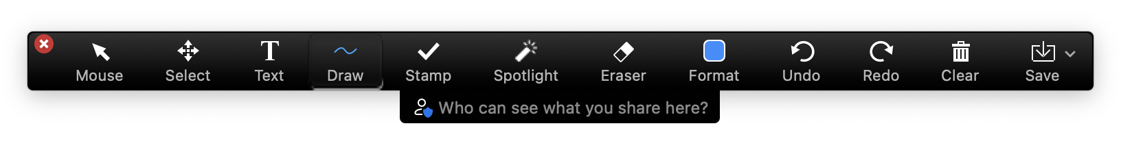
Conduct of a division officer
1
6
11
2
7
12
3
8
13
4
9
14
5
10
15
Notes:
Conduct of a Division Officer pages 50-51

Slide 61
Notes:
INSTRUCTOR - STOP sharing your slides

Slide 62
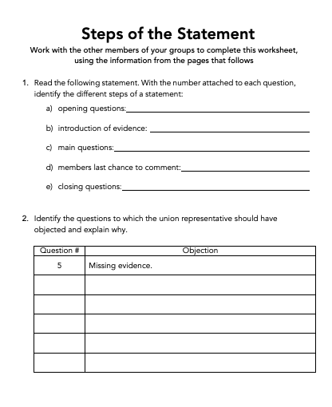
Notes:
Steps of the Statement pages 55-61

Slide 63
Notes:
INSTRUCTOR - STOP sharing your slides

Slide 64

Almost every TCRC collective agreement states that no employee shall be disciplined or discharged until a fair and impartial investigation or hearing has been conducted and responsibility established. Formal investigations, or statements as they are commonly called, are the first step of the investigation and discipline process. They represent the evidence that the company most heavily relies upon when assessing discipline and when they are defending their actions throughout the grievance procedure and also at arbitration.
Notes:
Disciplinary Investigation page 62

Slide 65
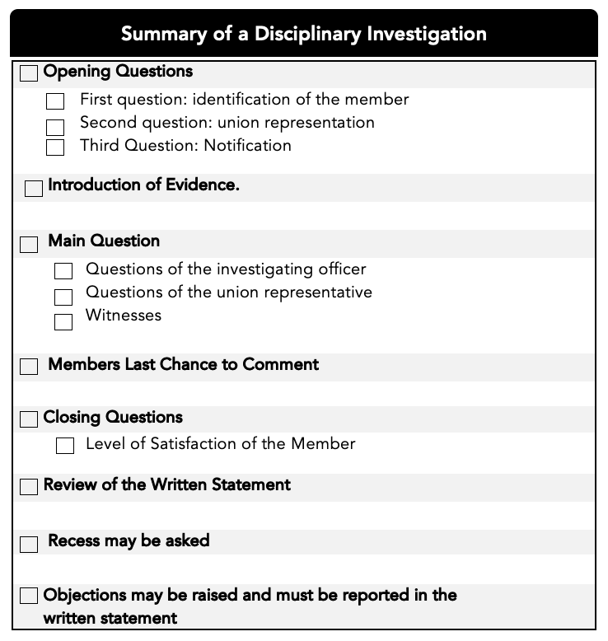
Notes:
Disciplinary Investigation page 62

Slide 66
The collective agreement defines rules to be followed by the company in order to respect the member’s right to a fair and impartial investigation. All employees are entitled to these essential rights when subject to a disciplinary investigation.
DISCIPLINARY INVESTIGATION
Notes:
Disciplinary Investigation page 63

Slide 67
Every employee has the right to…
adequate notice of details of the charges against them (Ad hoc 521, CROA 3322);
enough time to be prepared for the investigation hearing;
rebut witness statements made against them;
access material, statements and documents pertinent to the outcome of the investigation (CROA 1734) at the beginning
Notes:
Disciplinary Investigation page 63

Slide 68
Every employee has the right to…
ask for a witness (CROA 2920, 2934);
union representation during the investigation of a witness
state their case during the investigation;
an impartial/unbiased investigation officer (Ad hoc 548, CROA 3061,3167);
Notes:
Disciplinary Investigation page 63

Slide 69
Every employee has the right to…
object to any illegal questions asked, such as;
leading questions;
unfair or self-incriminating questions; (CROA 2934, 1420)
investigator is stalling or pressuring;
investigator going off from subject matter;
previously asked questions;
investigator is overlooking or avoiding a line of questioning;
recess, if necessary, during the investigation;
a timely hearing without undue delay;
copy of the written statement at the end of the investigation.
Notes:
Disciplinary Investigation page 63

Slide 70
Notes:
INSTRUCTOR - STOP sharing your slides

Slide 71
Preparing the member for an investigation
Question #1
When taking part in the investigation procedure, it is good practice to advise the member to offer any extra information and context they can think of that might be helpful when responding to questions.
True
False
Notes:
Preparing the member for an investigation pages 65-67
Correct answer is:
False
Top Up to include:
One of the most damaging practices a member can adopt is that of giving
long, rambling and voluntary statements. A member should confine the
answer to the question. If he or she volunteers or adds to what is asked,
that will invite additional questions and open up avenues of inquiry that the
investigating officer might otherwise overlook.
When the member is asked to tell in their own words all they know about
the occurrence, they should give a short answer and not go into detail. The
answer should be short and concise but contain all of the essential facts of
what happened and of their defence. The investigating officer is then
required to obtain the details by asking specific questions.

Slide 72
Preparing the member for an investigation
Question #2
Thinking of the checklist of points to tell the member in preparation for investigation interviews, which one of the following is NOT correct advice?
Sit up straight, don’t chew gum and speak audibly
Be courteous because when you behave in a discourteous manner, it could establish itself in the questioner’s mind as guilt
It’s ok to tell some jokes to lighten the mood
If you don’t know the facts required to answer a question, saying ‘I don’t know’ is perfectly acceptable
Notes:
Preparing the member for an investigation pages 65-67
Correct answer is:
It’s ok to tell some jokes to lighten the mood
Top Up to include:
Items 1-5 on the list

Slide 73
Preparing the member for an investigation
Question #3
Still thinking of the checklist of points to tell the member in preparation for investigation interviews, answer the following statements.
If you don’t understand a question, answer to the best of your ability.
True
False
Notes:
Preparing the member for an investigation pages 65-67
Correct answer is:
False
Top Up to include:
Much harm can be done answering a question you didn’t understand. Ask the questioner to repeat it.

Slide 74
Preparing the member for an investigation
Question #4
Don’t look at your representative when being questioned.
True
False
Notes:
Preparing the member for an investigation pages 65-67
Correct answer is:
FalseTop Up to include:
Don’t Rely on Your Representative for your Answer- Don’t look at your
representative when being questioned. This merely discredits your
statement and gives the impression that the representative is putting words
in your mouth. Look directly at the person asking the questions

Slide 75
Preparing the member for an investigation
Question #5
If you realize you have made a mistake in answering a question earlier in the interview, you should go back and correct it.
True
False
Notes:
Preparing the member for an investigation pages 65-67
Correct answer is:
True
Top Up to include:
Don’t stick to mistakes…go back and correct. Remember it is the member’s statement, not the Company’s.

Slide 76
Preparing the member for an investigation
Question #6
At the end of the interview, the member will be asked about whether the statement has been taken in a fair and impartial manner. If they feel it has, they answer ‘yes’.
True
False
Notes:
Preparing the member for an investigation pages 65-67
Correct answer is:
False
Top Up to include:
15) Ensure you never answer yes to the question about whether the statement
has been taken in a fair or impartial manner. State only “Let the record
speak for its self”.

Slide 77
steps of the statement
The notification
Opening questions
Review of material, documentation
The version of facts of the member
The investigator questions
The member’s last chance
The end of the statement
Written statement
Notes:
Steps of the Statement pages 68-74

Slide 78
Group 1: 1 and 5 Group 2: 2 and 6 Group 3: 3 and 7 Group 4: 4 and 8
Notes:
Steps of the Statement pages 68-74

Slide 79
Notes:
INSTRUCTOR - STOP sharing your slides

Slide 80
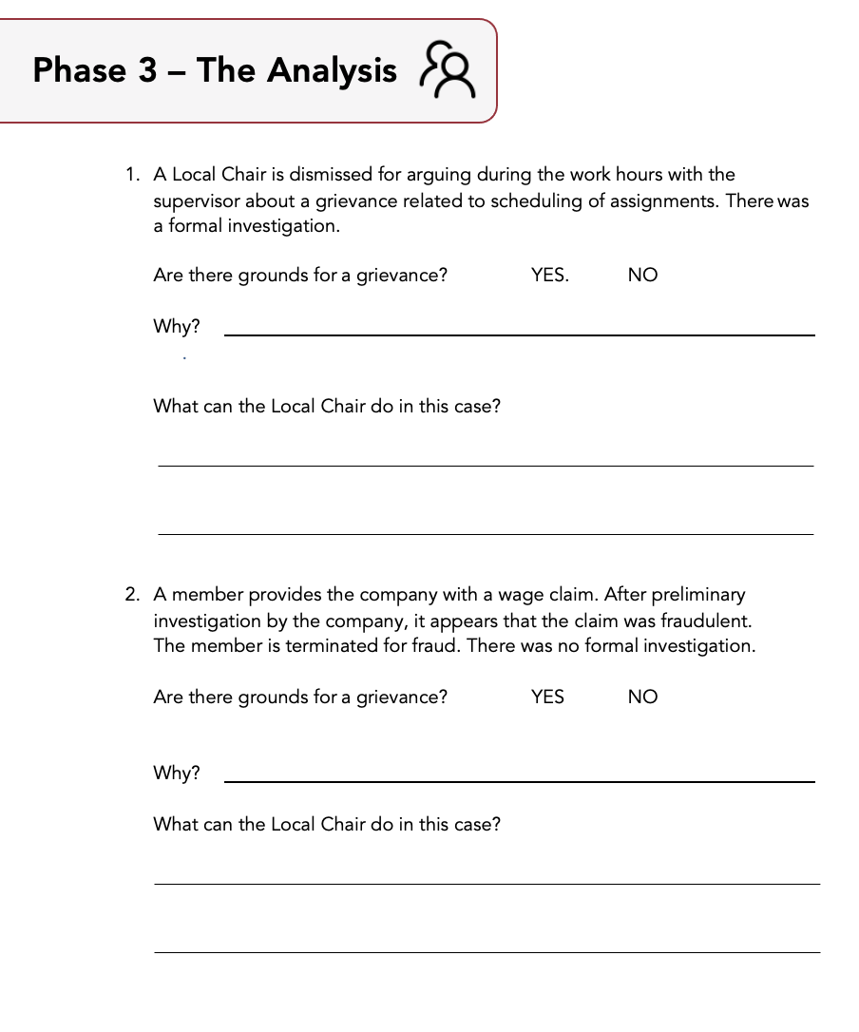
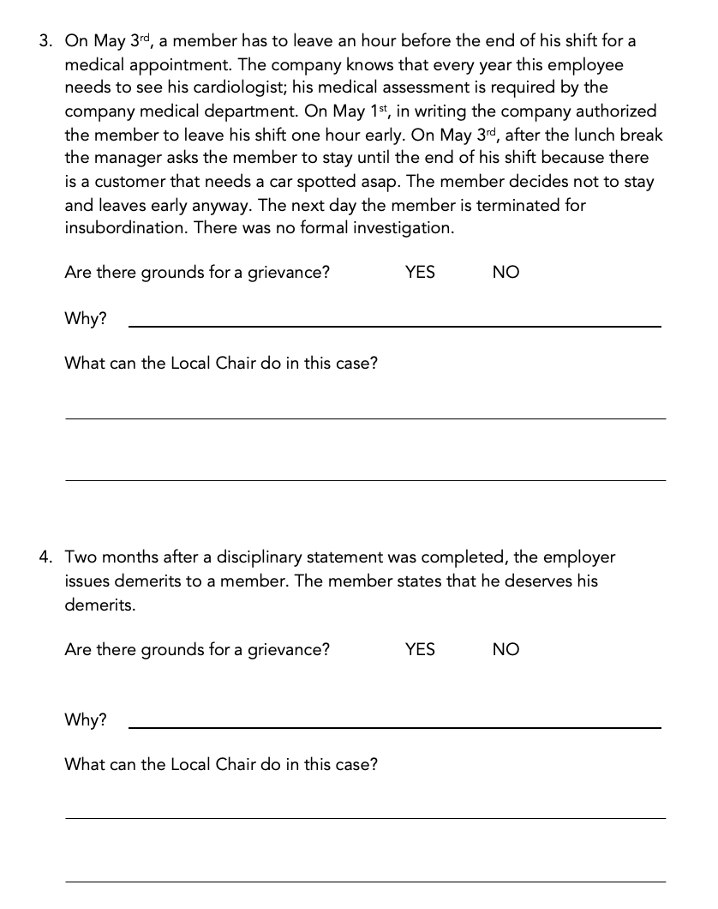
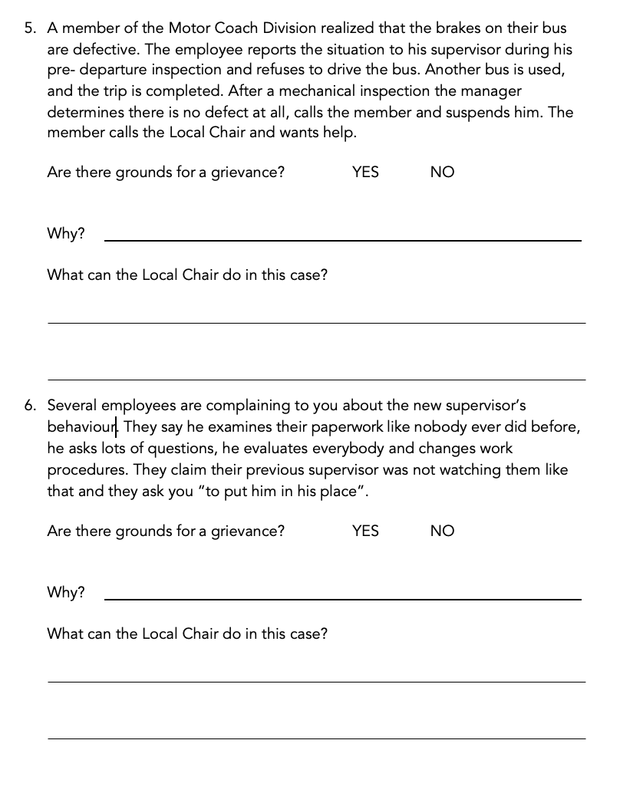
Notes:
Phase 3 - The Analysis pages 78-80

Slide 81
Notes:
INSTRUCTOR - STOP sharing your slides

Slide 82
WHAT DO YOU THINK?
CROA 3679
Notes:
CROA 3679 page 90
http://croa.com/PDFAWARDS/CR3679.pdf

Slide 83
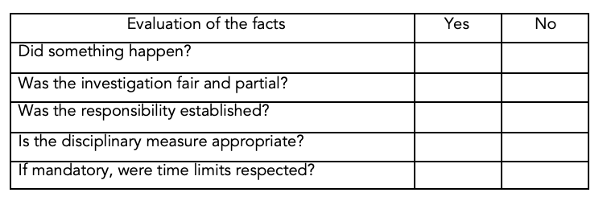
CROA 3679
Notes:
CROA 3679 page 90

Slide 84
Notes:
INSTRUCTOR - STOP sharing your slides

Slide 85
WHAT DO YOU THINK?
CROA 3680
Notes:
CROA 3680 page 91
http://croa.com/PDFAWARDS/CR3680.pdf

Slide 86
CROA 3680
Notes:
CROA 3680 page 91

Slide 87
Notes:
INSTRUCTOR - STOP sharing your slides

Slide 88
Drafting a grievance letter
If there is no settlement and there are grounds to file a grievance, file it within the time limits provided in the Collective Agreement.
Notes:
Drafting a Grievance Letter pages 95-98

Slide 89
Write it up
This is where the entire fact finding comes together.
Make sure you are sending it to the correct person.
Do you have an agreement to exchange grievances electronically? Can you confirm receipt?
Develop your own style of writing that you are comfortable with and develop your own way of closing out the letter. Don’t write a novel. Be accurate and precise. Make a clear accusation and don’t forget to include the remedy sought.
Remember, you are not a lawyer and don’t need to be one either!
Act professionally and write a letter the same way.
Keep the griever advised and up to date with what is taking place.
Advance the grievance
Notes:
Drafting a Grievance Letter pages 95-98

Slide 90
Drafting a grievance letter
First paragraph - What step of the grievance procedure is it?
Second paragraph - What has happened?
Third paragraph - Make a definitive accusation or point.
Fourth paragraph - Be clear and state what it will take to settle the dispute
Notes:
Drafting a Grievance Letter pages 95-98

Slide 91
Notes:
INSTRUCTOR - STOP sharing your slides

Slide 92
Jack black 20-day suspension
What do you like about this example?
Anything you would change or improve?
Notes:
Pages 102-103

Slide 93
Notes:
INSTRUCTOR - STOP sharing your slides

Slide 94
The settlement
Make certain that the settlement is consistent with the terms of the Collective Agreement
Notes:
Phase 6 - The Settlement page 112

Slide 95
When meeting with the company…
Be confident and positive (you represent the union)
Stick to the point
Be prompt
Keep others informed
Some things to avoid…
Notes:
Meeting with the Company pages 114-115

Slide 96
Issues to consider in a grievance settlement
Dispute of time claim
Without precedent or prejudice
Notes:
Issues to consider page 116

Slide 97
Notes:
INSTRUCTOR - STOP sharing your slides

Slide 98
Question #1
When transferring the grievance file to the General Chair, you must include all evidence and documentation including statements, discipline forms or records and medical records and any post discharge evidence, as necessary. What is missing from this list?
A copy of the grievance process
A written explanation as to why the file is being advanced
Your personal opinion on the outcome
An outline of the role of the General Chair
Notes:
Phase 7 - Transfer the File to the General Chair pages 118-120
Correct answer is:
A written explanation as to why the file is being advanced
Top Up to include:
Remember, the General Chair should not have to read
through all of the material and try to determine what it is that is in dispute. That is the role of the Local Chair. Explain the merits of the case to the General Chair and offer up rebuttal argument or fact to the employer’s declination of the grievance, or the position the company has advanced in disputing the claim(s).
Explain to the General Chair what the expectations are, if any, along with an
explanation of whether or not there is anything further that is being sent in, or
being waited for.
Explain if there’s an expectation of success or is the grievance related to whom the grievance involves and not necessarily the facts of the case.

Slide 99
Question #2
When you advance a grievance to the General Chair, you advise the griever this has been done. A file advanced to the general chair has a greater chance of success for the griever.
True
False
Notes:
Phase 7 - Transfer the File to the General Chair pages 120-122
Correct answer is:
False
Top Up to include:
The facts of the case will determine the outcome of the case regardless of what level the grievance is advanced to.

Slide 100
Question #3
Select the statements that are true.
Each General Chair and General Committee follows the same practices on administering grievances
Each General Chair and General Committee may have developed their own practices on administering grievances
A General Committee may have their own bylaws pertaining to the handling of grievances
Notes:
Phase 7 - Transfer the File to the General Chair pages 120-122
Correct answer is:
Each General Chair and General Committee may have developed their own practices on administering grievances
A General Committee may have their own bylaws pertaining to the handling of grievances
Top Up to include:
You should familiarize yourself with how the General Chair or General Committee has chosen to administer grievances.

Slide 101
Question #4
Once the General Chair has received the grievance file and reviewed the facts, they may: (select the correct option)
Determine the merits of the case given the information they were provided. There is no allowance to seek additional information.
Ask the Local Chair or griever for more information as needed.
Notes:
Phase 7 - Transfer the File to the General Chair pages 120-122
Correct answer is:
Ask the Local Chair or griever for more information as needed.
Top Up to include:
Upon receipt of a grievance file, the General Chair will review the facts of the
grievance and depending on the circumstances may ask the Local Chair or the
griever for additional information. They may possibly request a signed “release of information” form from the griever so the Union may access certain private files in the possession of the employer, or perhaps in possession by a medical
practitioner who is involved with the griever. The General Chair will generally
communicate through the Local Chair and may not, unless the circumstances
warrant, communicate directly with a griever.
The General Chair may also determine that there is no merit to the facts of the instant case. In this situation they will normally write back to the Local Chair explaining that decision. In such a case the file will normally be closed and not progressed any further.

Slide 102
Question #5
Why is referencing the Collective Agreement important in handling grievances? Check all that apply.
CA’s can determine when the grievance process officially starts.
Some CA’s can call for a ‘joint conference’ between the General Chair and the employer.
Most CA’s outline the same process for grievances, so it is good to review the CA but they’re not necessarily ‘important’.
Notes:
Phase 7 - Transfer the File to the General Chair pages 120-122
Correct answer is:
CA’s can determine when the grievance process officially starts.
Some CA’s can call for a ‘joint conference’ between the General Chair and the employer.
Top Up to include:
This is the time to discuss the importance of the CA to the learners.
Timing, special processes, FMCS, grievance meetings, etc.
There are some Collective Agreements that begin the grievance process at the
General Chair’s level, when involving discharge, suspension, demerit marks in
excess of 30 and restrictions. In these circumstances it is particularly important
that the General Chair receives all of the relevant information and documentation,
and all done in a timely manner.
There are specific time limits involved at this level of grievance handling. Some
Collective Agreements call for a “joint conference” between the General Chair and
the employer once the grievance has been advanced by the General Chair. The
purpose of these meetings is to possibly settle the grievance.
In most cases the General Chair will have discussions with senior managers about
the grievance, regardless of whether or not there is any likelihood of settlement. It
is very important that the General Chair is aware of all the facts, and anything that has taken place since the filing of the grievance, and which may be related to the
dispute. This is particularly important in cases of discharge or significant discipline.

Slide 103
Question #6
If the grievance has been advanced by the General Chair, and through discussions with the employer has been declined, or not settled through joint discussions, then the grievance is advanced to final and binding arbitration.
True
False
Notes:
Phase 7 - Transfer the File to the General Chair pages 120-122
Correct answer is:
False
Top Up to include:
That may be one outcome, but there are others:
Should the grievance be advanced by the General Chair and ultimately declined
by the employer, or not settled through joint discussions, there are really several
options at that point.
o Review and reconsider the facts and should there be insufficient merit to
proceed, the General Chair may close the file.
o The General Chair may want to continue to discuss the issue or issues with
the employer in an effort to obtain an acceptable settlement.
o The issue or issues are advanced to final and binding arbitration.

Slide 104
Notes:
INSTRUCTOR - STOP sharing your slides

Slide 105

www.croa.com
Notes:
CROA - page 122

Slide 106
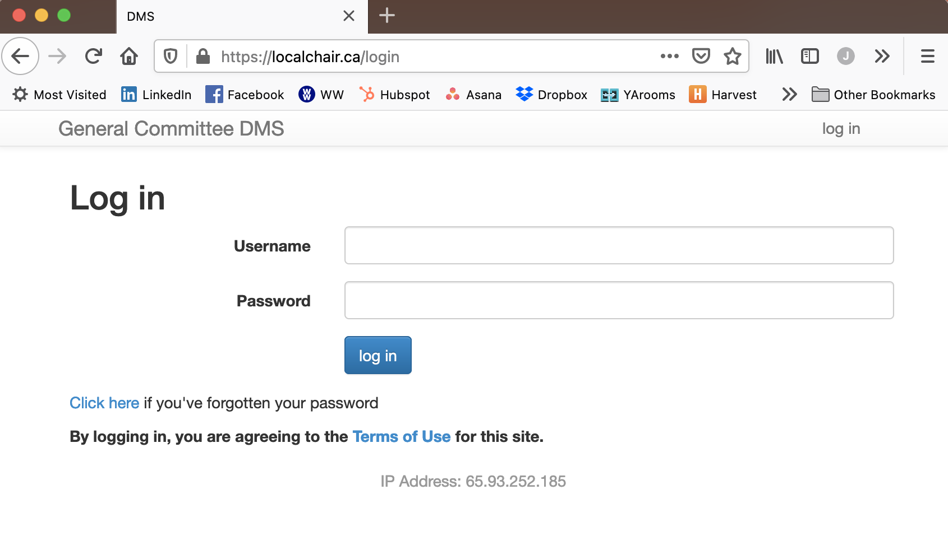
Notes:
Page 123

Slide 107
Res judicata
a matter which has already been conclusively decided by a court between the parties
a final judgment that prevents any re-examination or re-trial of the same dispute
does not apply to discipline and discharge cases
Notes:
Res Judicata page 124

Slide 108
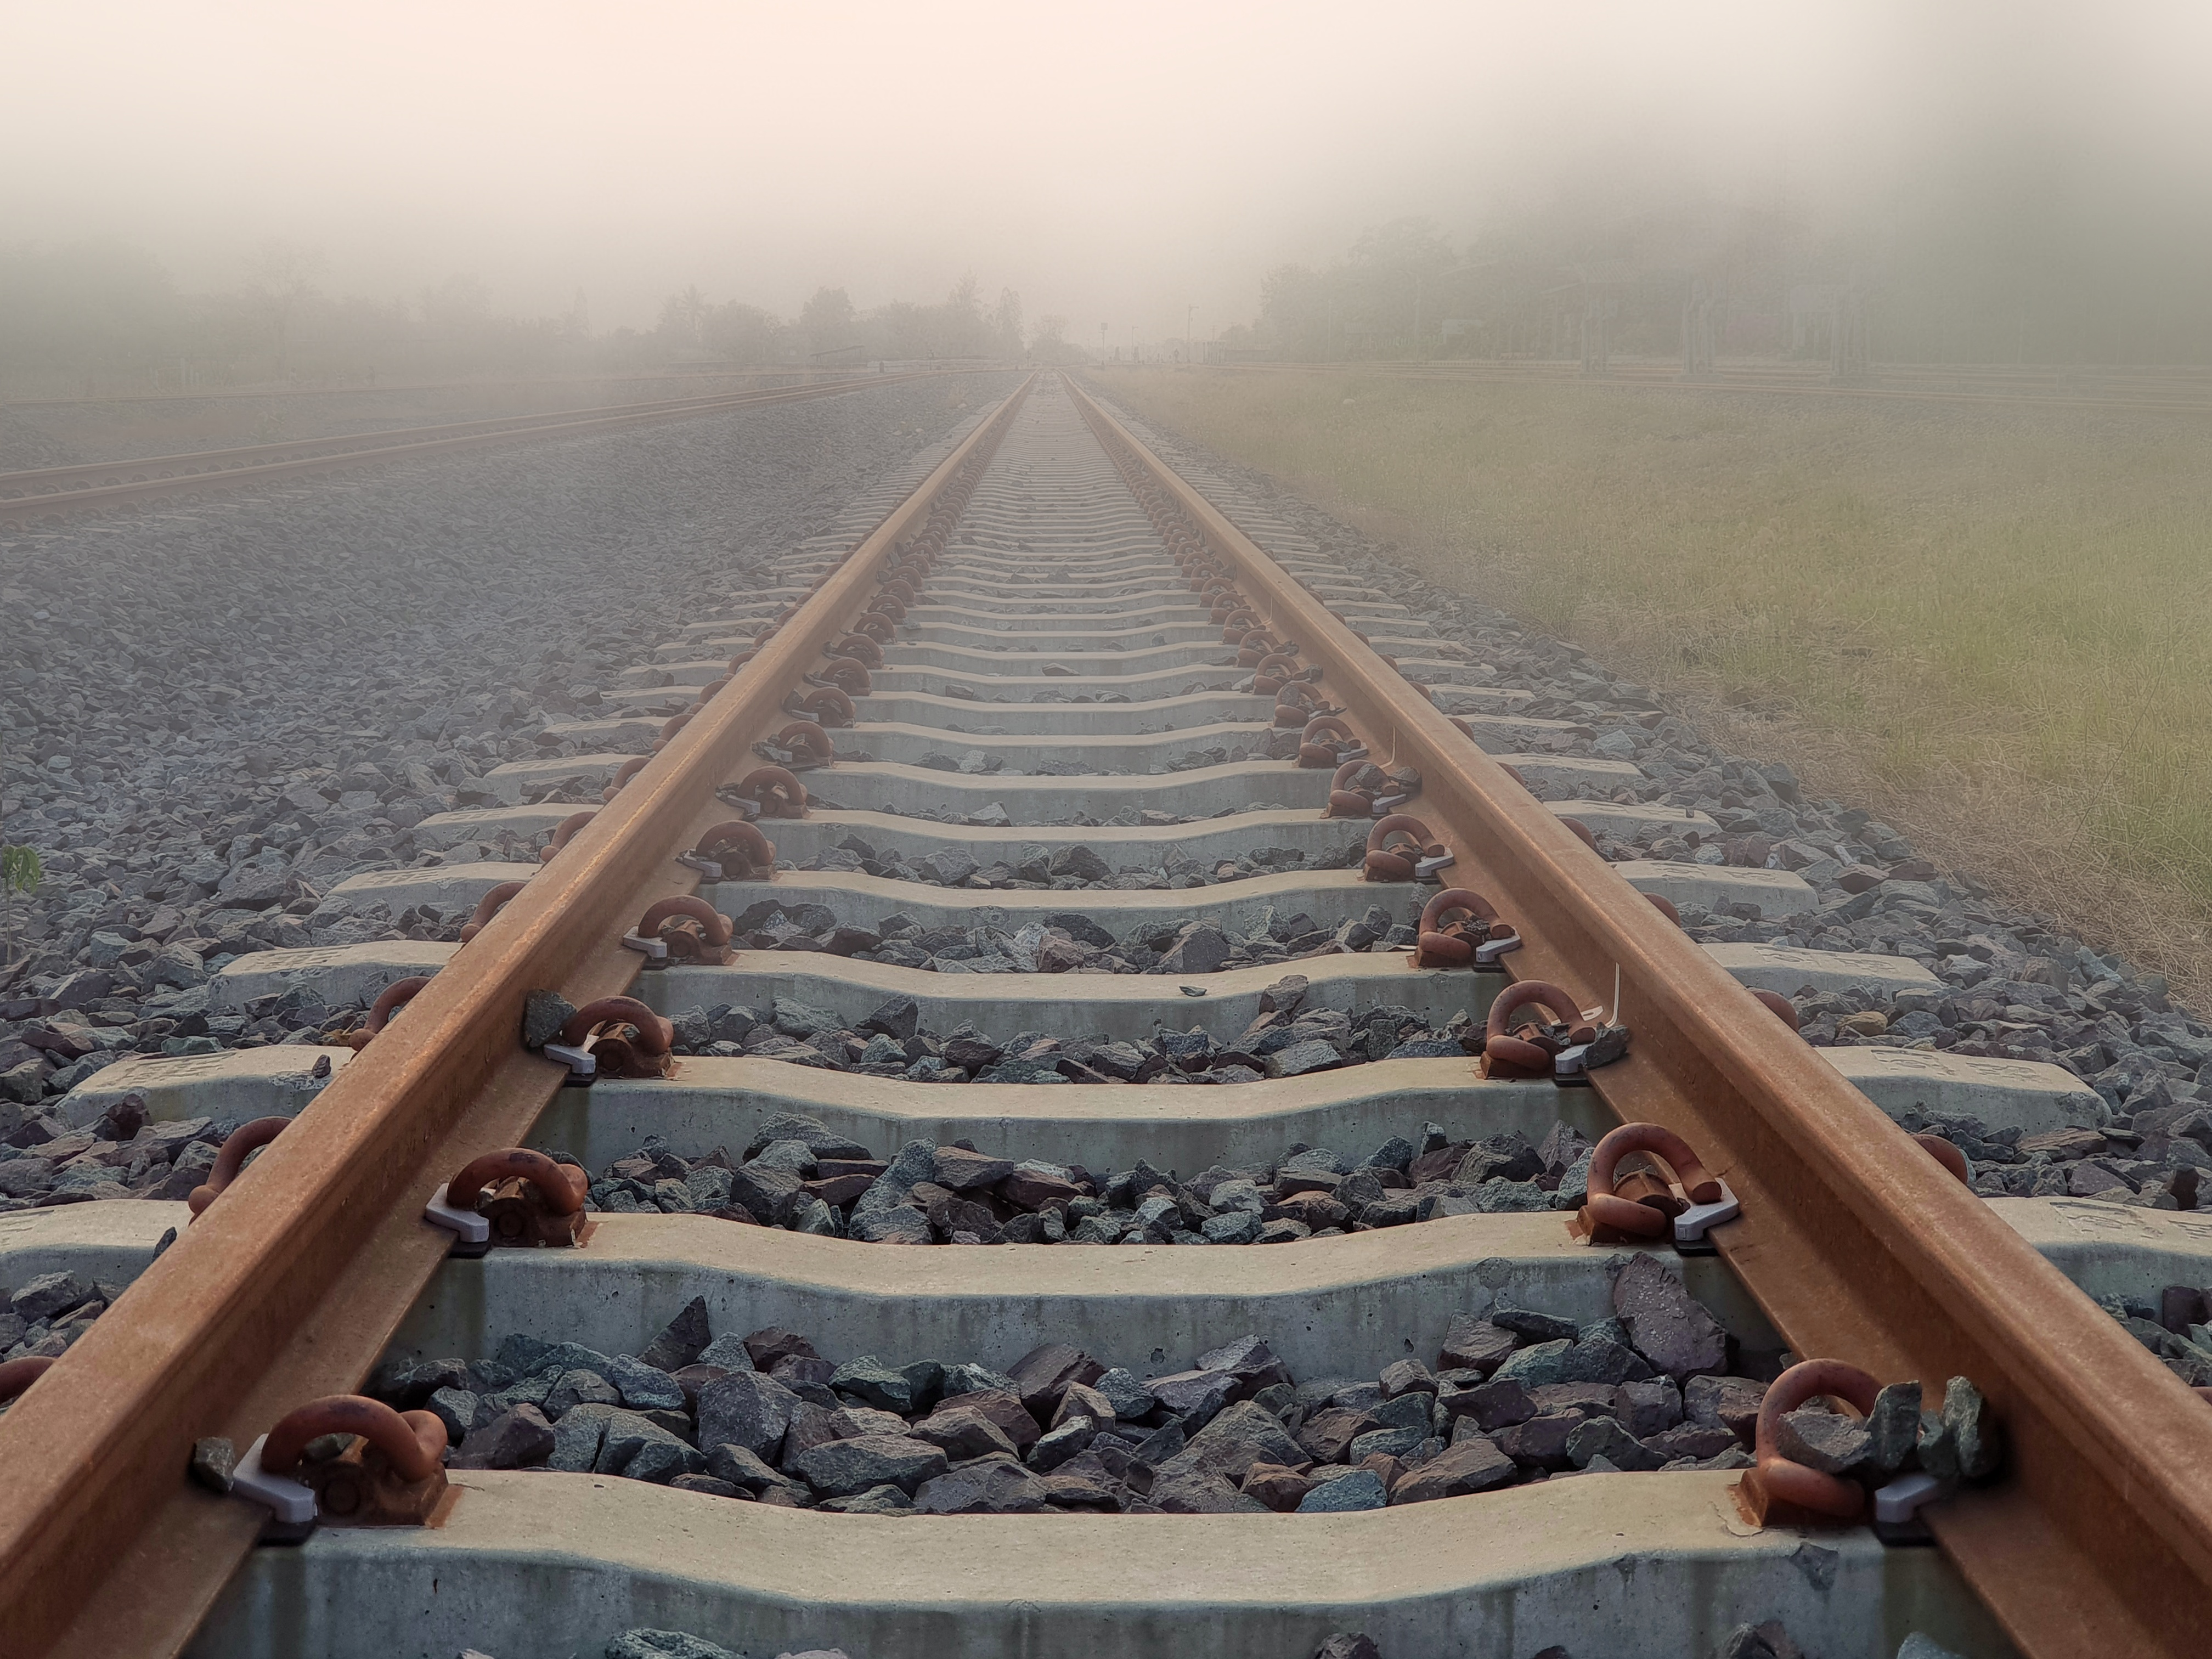
I am…
I believe…
I will…
Notes:
Call to Action page 126

Slide 109
Notes:
INSTRUCTOR - STOP sharing your slides

Slide 110
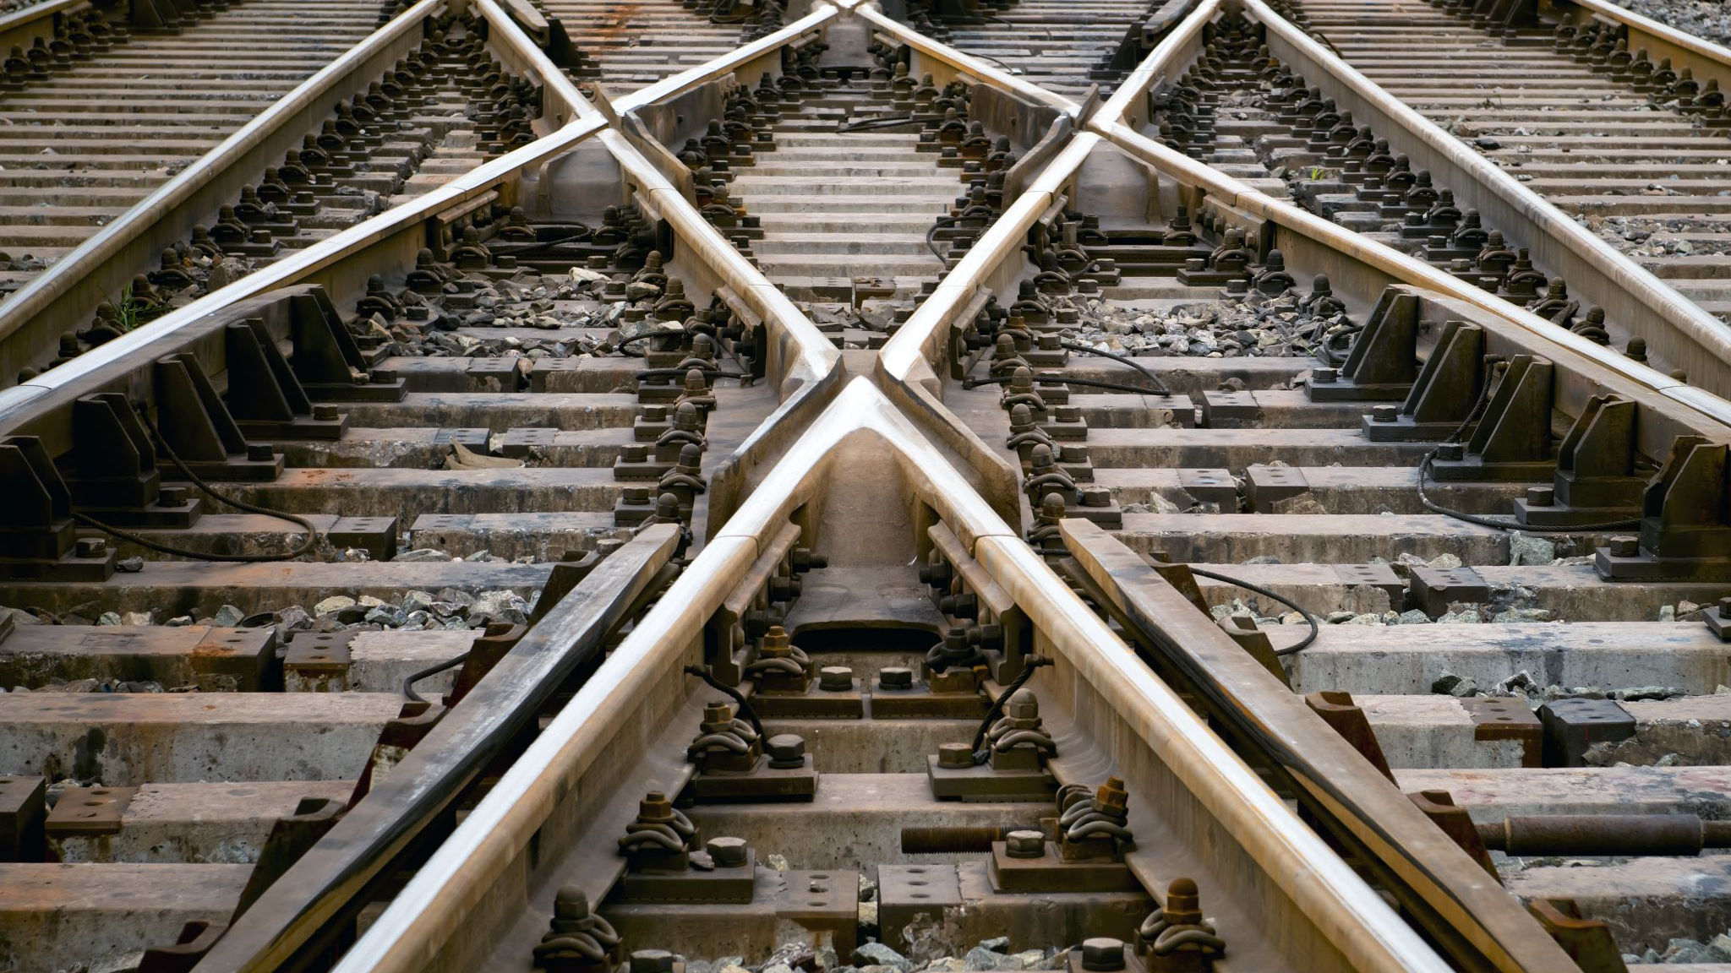
Let your actions inspire others to dream more, learn more, do more, and become more! Be a leader!
Notes:
Conclusion - page 129

